Slide 1

University admit eligibility predictor using IBM Watson
Team members:
B. Sai Chandra Lekha
N. Sandhya Rani
Yarraboina Venkata Sravya
Bemini Ramu
P. Pavithra

Slide 2
Index
Introduction
Data collection
Data Preprocessing
Model Building
Application Building
Train the model on IBM

Slide 3
INTRODUCTION
Student admission problem is very important in educational universities. Students are often worried about their chances of admission to University. The aim of this project is to help students in shortlisting universities with their profiles.
In this project, we will be using the Admission_predict dataset in csv format to predict the chances of students getting admission by a university based on several academic performance measurement. To yield the most accurate result, we will be going through several steps such as data preprocessing, train-test, feature selection, cross validation, model selection, etc. to train a linear regression model, make prediction and measure its performance.

Slide 4
DATASET
The dataset contains several parameters:
GRE Scores ( out of 340 )
TOEFL Scores ( out of 120 )
University Rating ( out of 5 )
Statement of Purpose and Letter of Recommendation Strength ( out of 5 )
Undergraduate GPA ( out of 10 )
Research Experience ( either 0 or 1 )
Chance of Admit

Slide 5
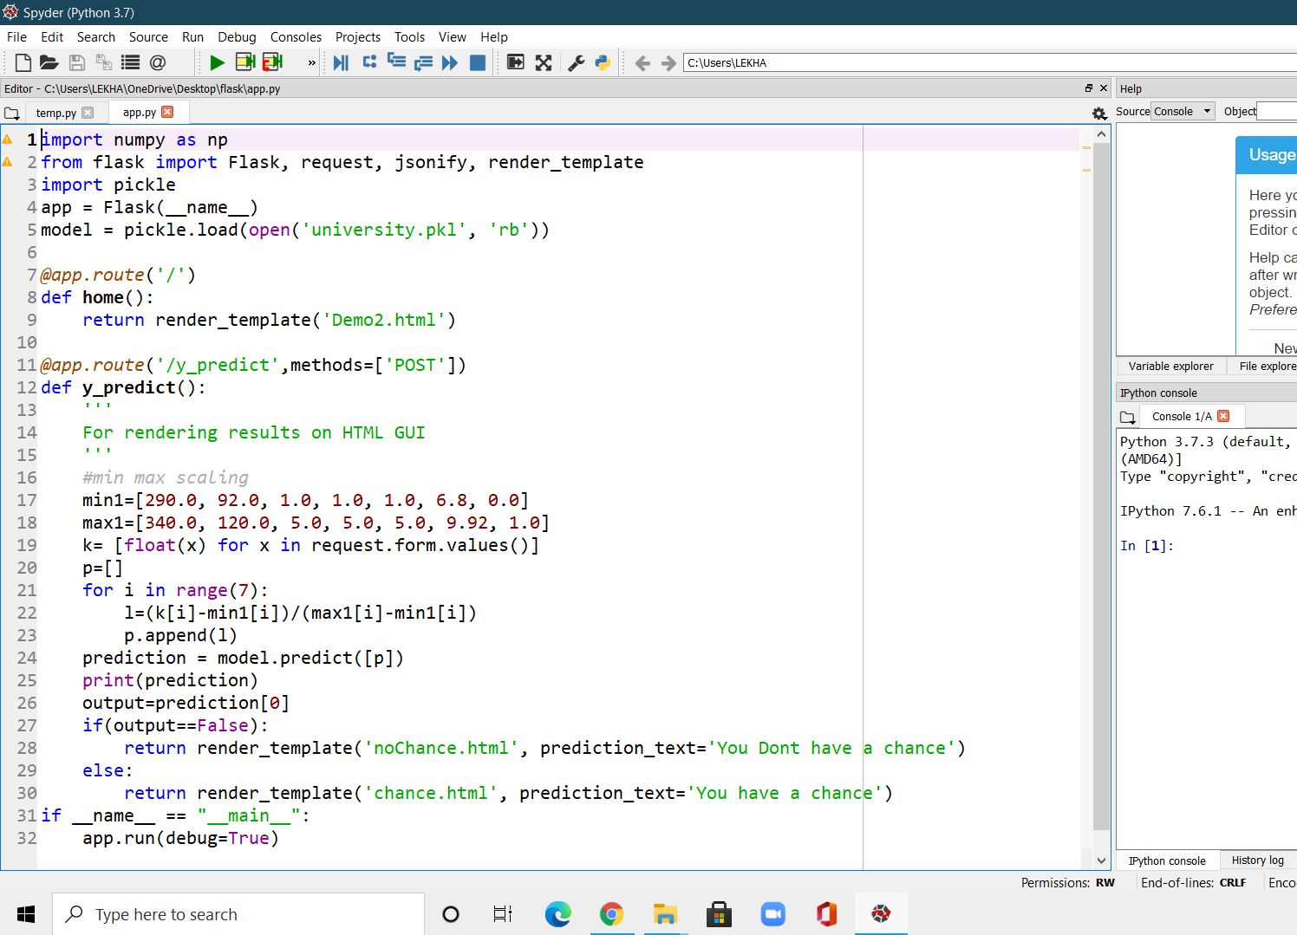
APP CODE

Slide 6
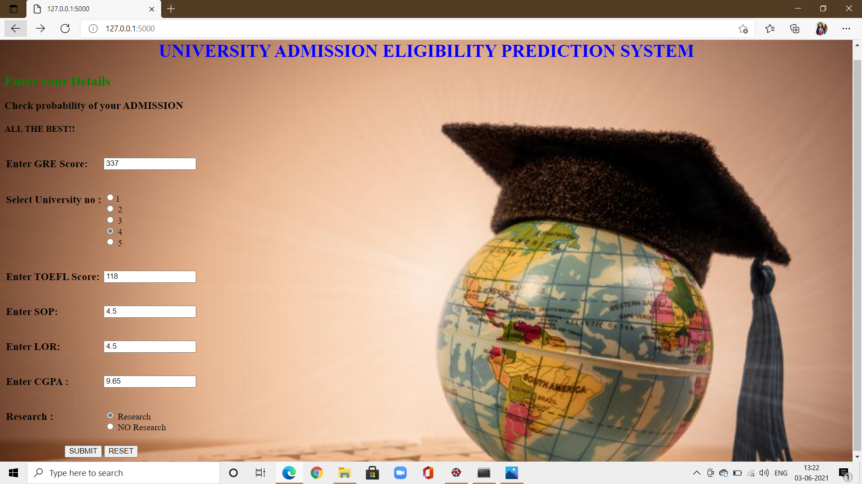
When we run app, this web page will be opened. Now we have to give the values i.e., scores

Slide 7
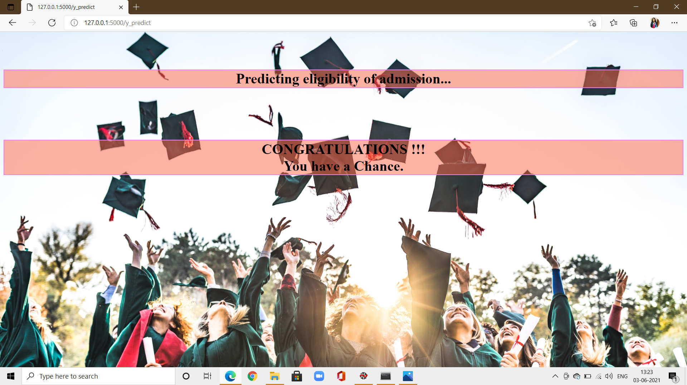

Slide 8

Again when we gave input values, according to our score it gives output

Slide 9
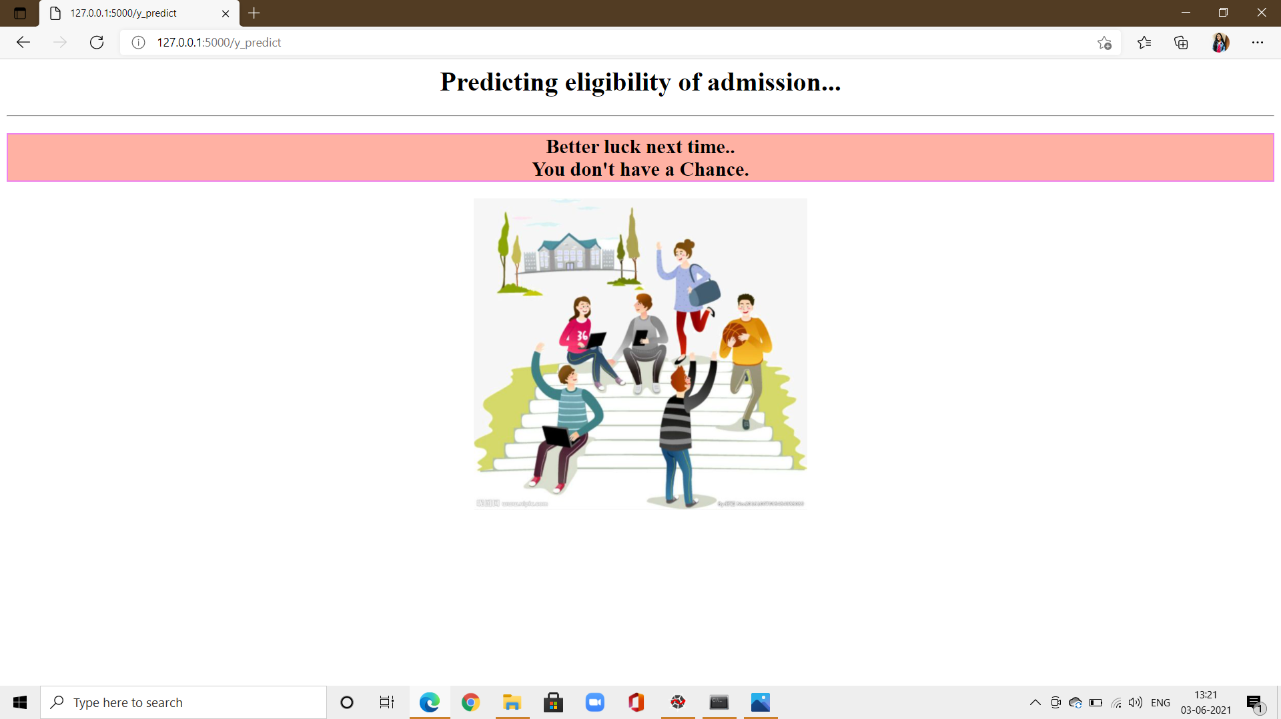

Slide 10
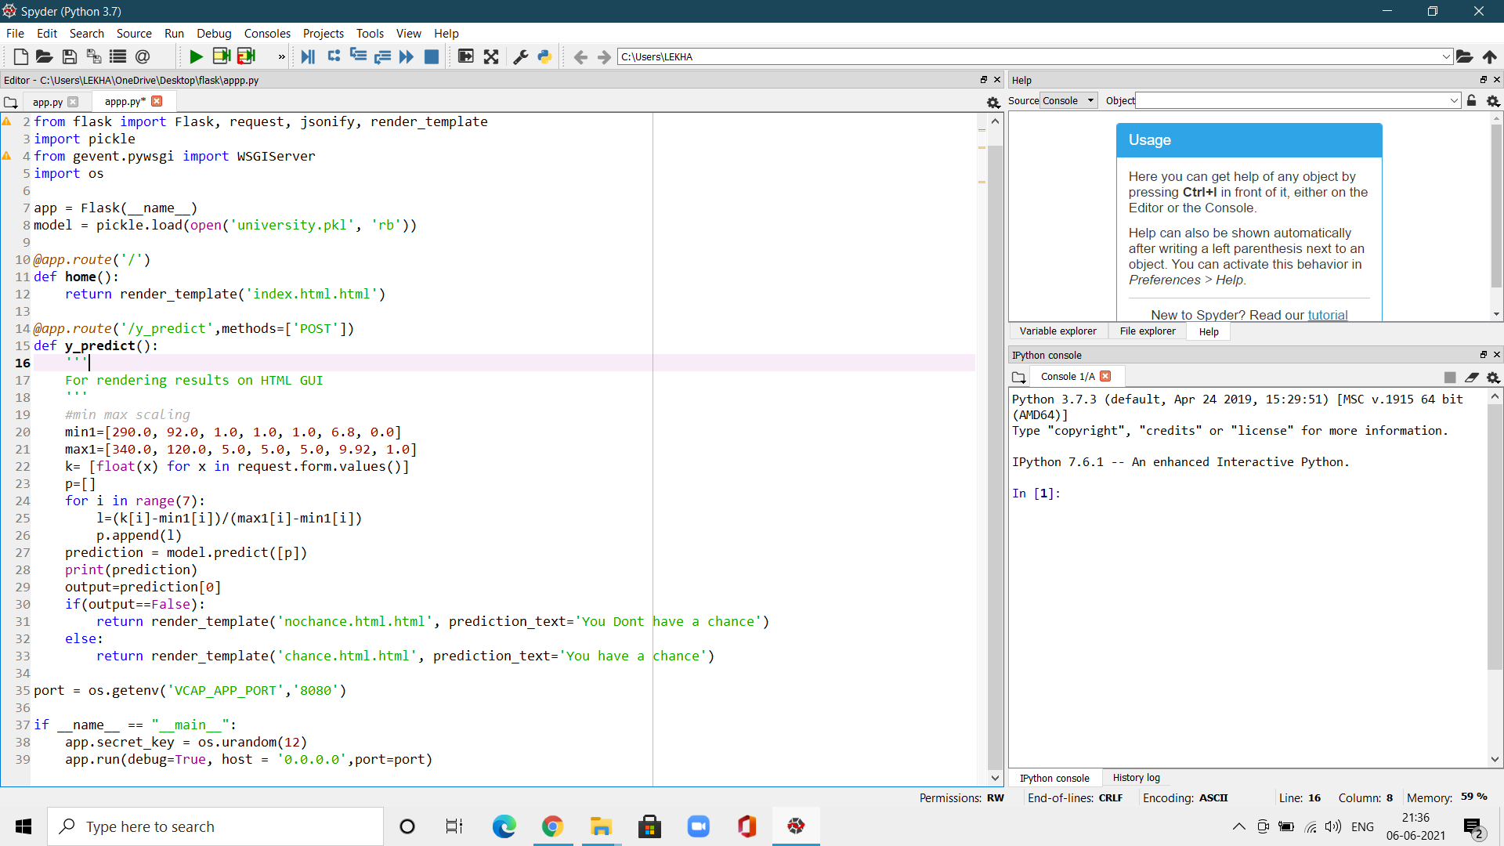
APPLICATION BULIDING
Deployment of app and pushed into IBM cloud foundary app..

Slide 14
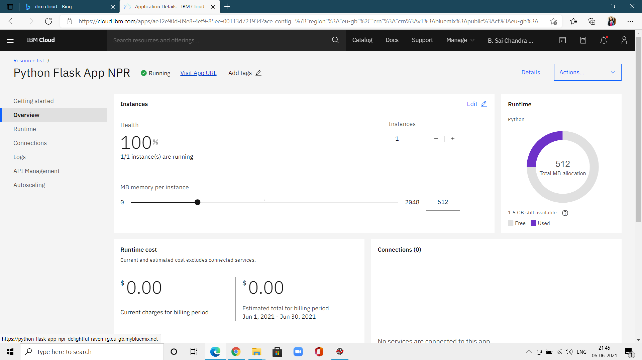

Slide 15
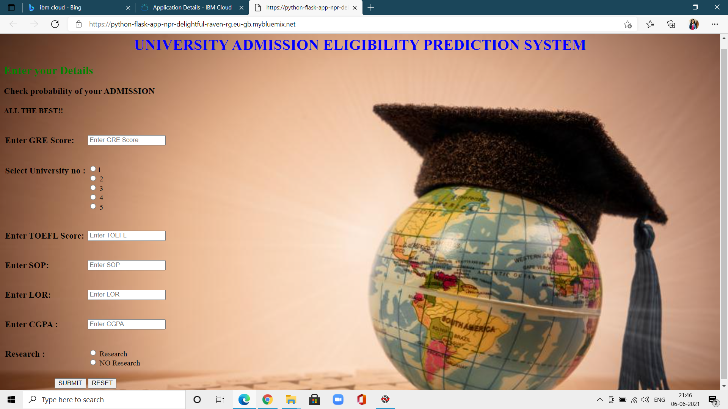
APP IS DIRECTED INTO THE WEBPAGE

